Slide 1
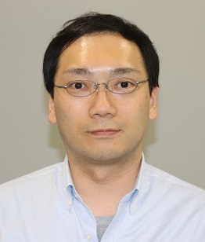
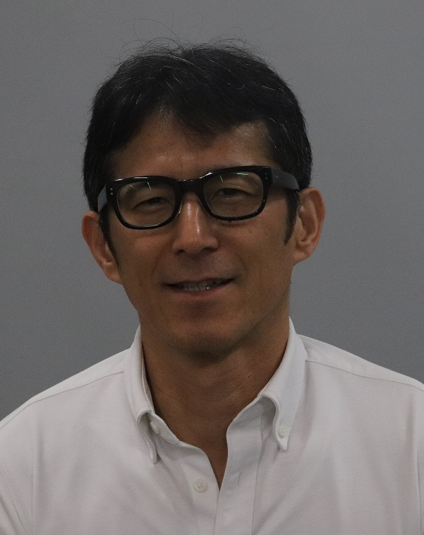
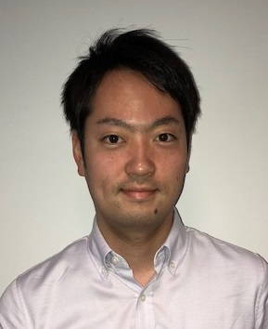
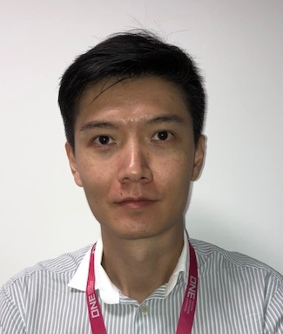
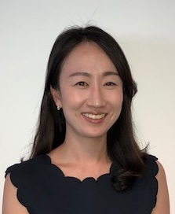
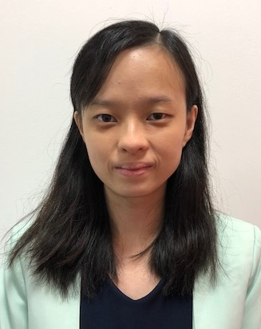
3-7. Digital Yield Management
Strategy, Tiger and Titan Project Team
Digital Yield Management
Kenichi Michida
Senior Vice President
Team
Team Lead
Unit
* In Hong Kong
Genji Ryo
Deputy General
Manager
Shogo Otsuka
Manager
Manoj Agarwal
Senior
Manager
Titan Project
Tiger Project
Strategy
Titan Project
Tiger Project
Plan & Coordination
Vincent Yip
Manager
Kimmi Kang
Manager
TBD
Kawah Lau
Senior
Executive
Chia
Gek Hui
Senior
Executive
Sharon Tang
Executive
* Titan Team is located in HKG

Slide 2
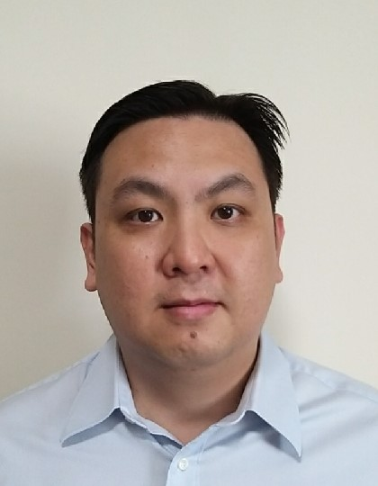
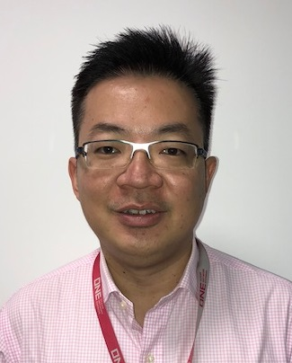
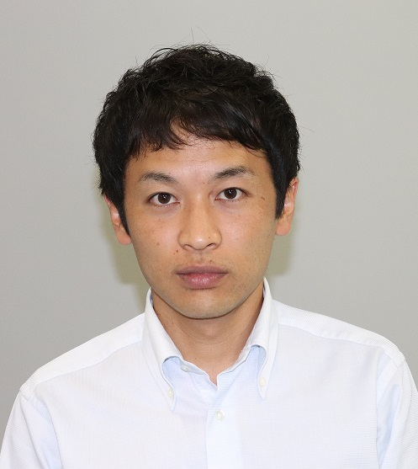
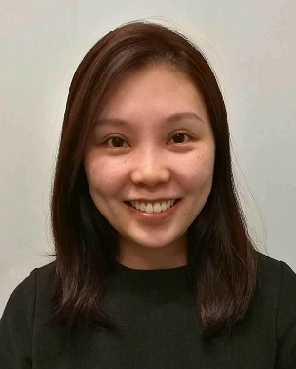
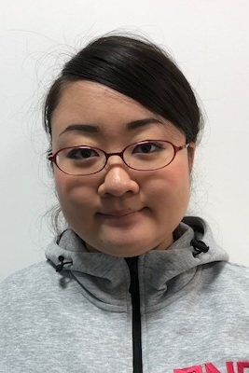
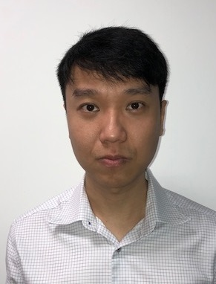
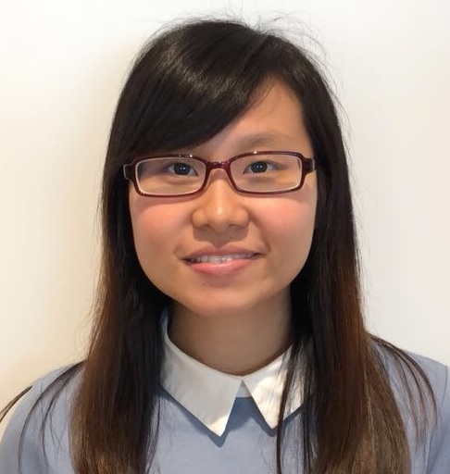
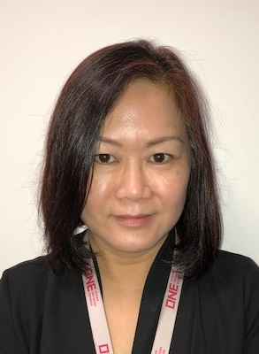
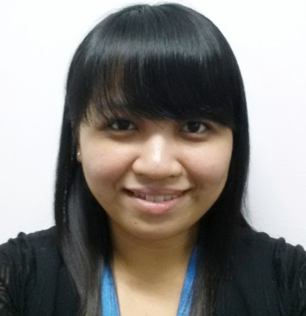

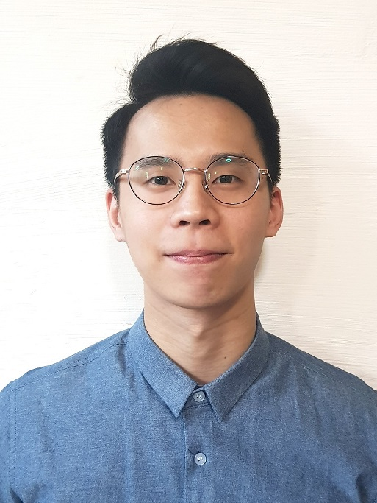
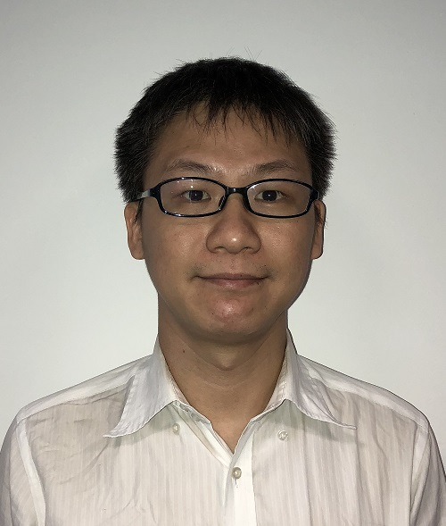
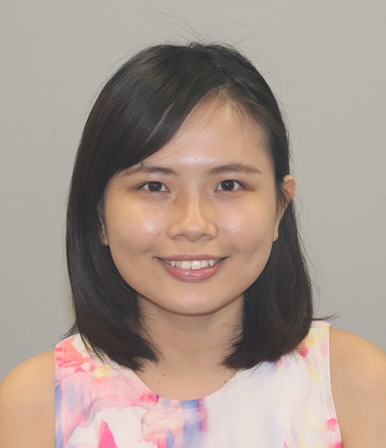
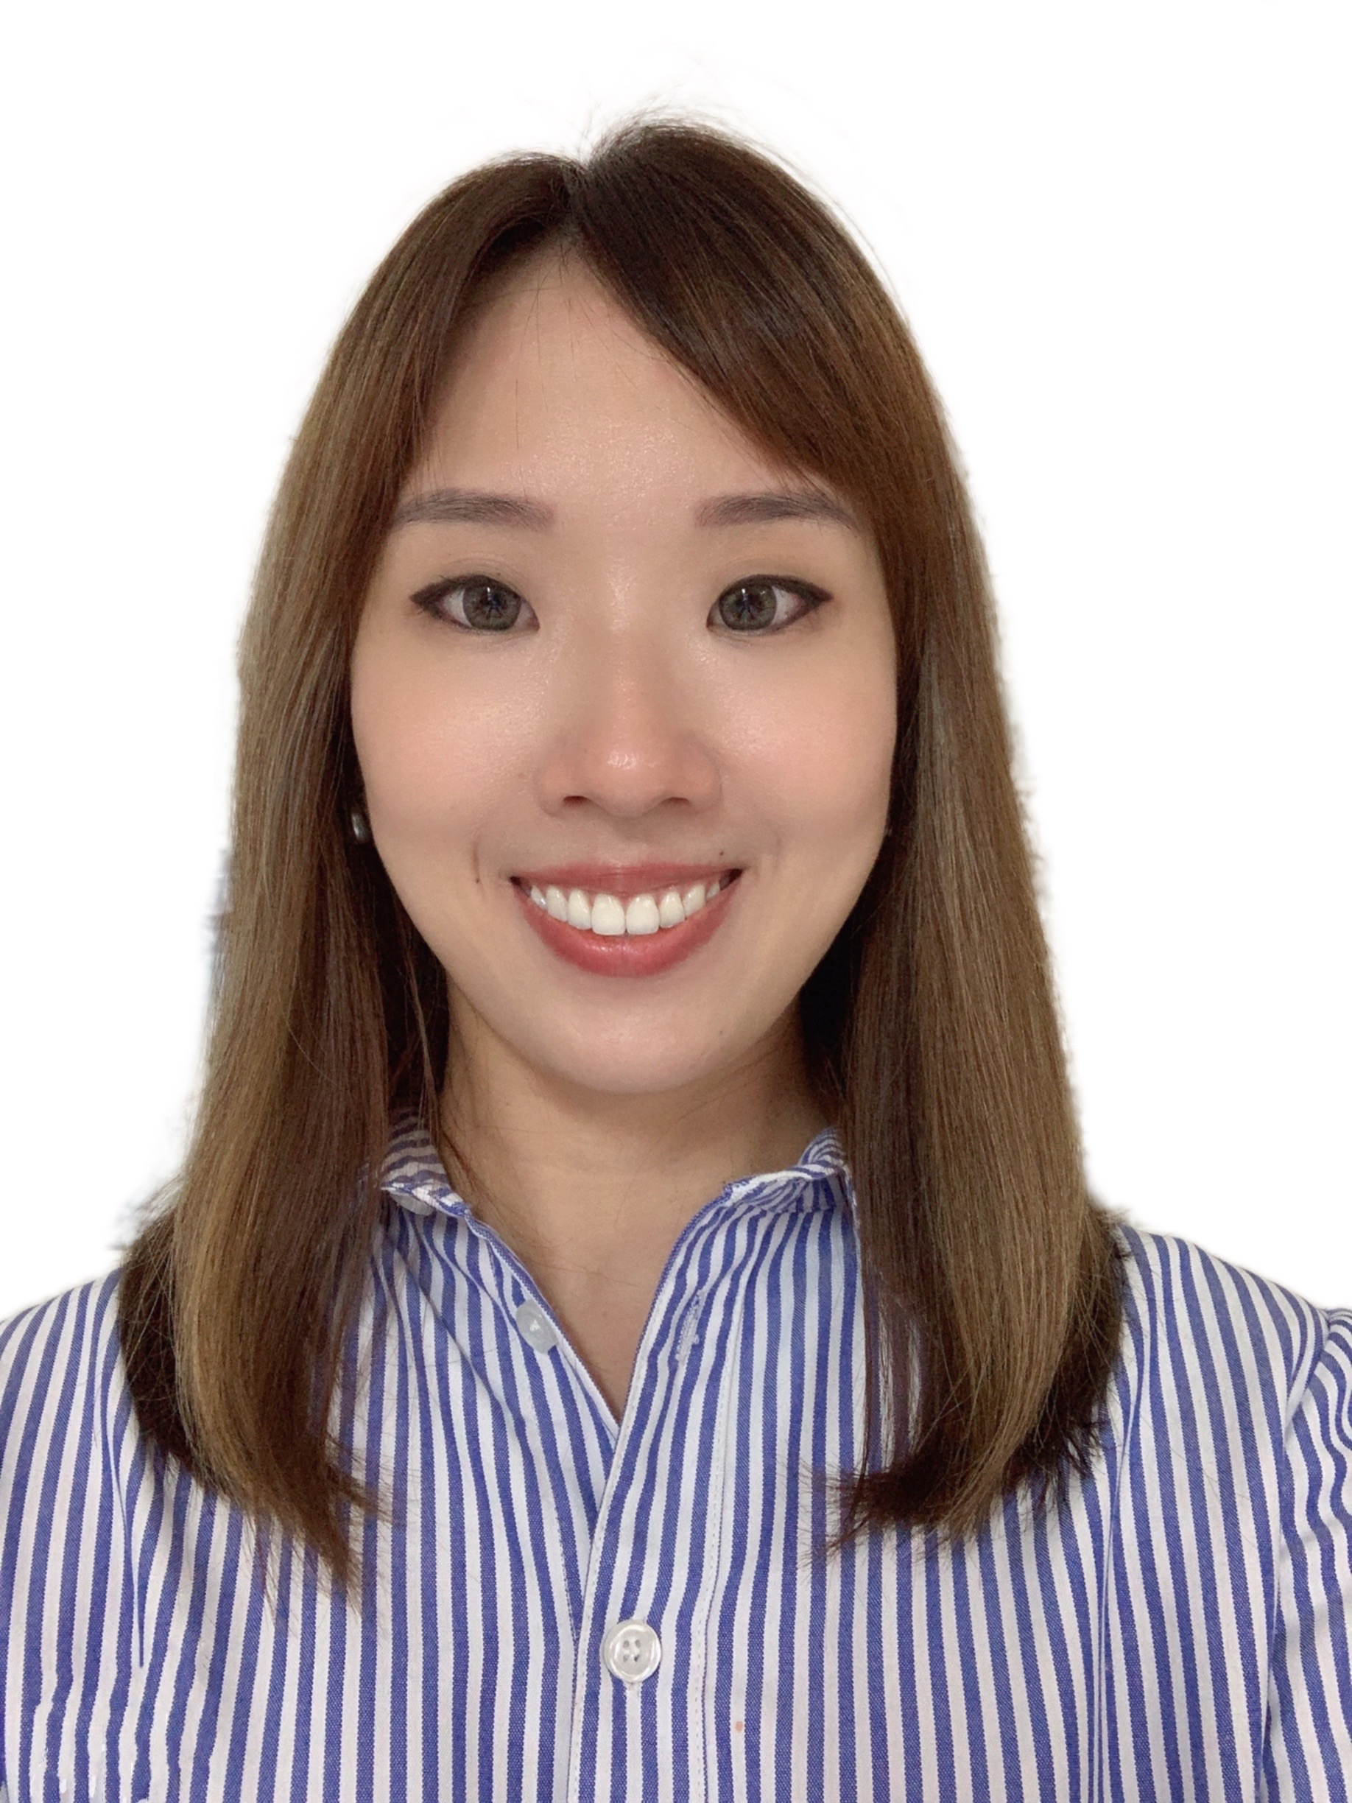
3-7. Digital Yield Management
BPM & Innovation Team
Yii Rui
Project
Manager **
Digital Yield Management
Kenichi Michida
Senior Vice President
Team
Team Lead
DX Task Force
Unit
BPM Commercial Lead
Lee Kok Choon
Deputy General
Manager
Go Imai
Manager
Advance Technology
Analysis
BPM
Kazuki Masuda
Manager
Advanced Technology
Data CoE
PRI/DMT
ACM/COA
BSA/SPC/Standby
PRD
* In Hong Kong
Tang Yee Lar
Manager
Manoj Agarwal
Senior
Manager
Misato Gozu
Assistant
Manager
Ng Zhong Da
Assistant
Manager
Wan Yan Sia
Assistant
Manager
Karen Chuang
Assistant
Manager
Vivian Teh
Senior
Executive
Jennifer Ang
Senior
Executive
Marcus Teo
Senior
Executive
Elson Siew
Senior
Executive
Yong Jin Yu
Senior
Executive
Trisha Ng
Senior
Executive
** From OTSS

Slide 3
3-7. Digital Yield Management
Strategy | Tiger | Innovation | BPM
Strategy Trade & Marketing DX (digital transformation) planning and execution control including resources and budget Project management office for ONE QUOTE and other new projects Tiger Project Pricing Engine (TIGER) project management Pricing process revision which enable connect to other modules like ONE QUOTE, TITAN and others Innovation Providing new solutions to M&C business activities by applying advanced technologies by 3rd party partners DDE (Data Driven) project management and Light PoD management Eagle Plus system enhancement Report creation and process management related to Trade/Marketing activities BPM (Business Process Management) Data governance for the related modules PRD, COA, SPC(Stand By) and DMT module process, system development and related project management Collaboration with OMMC BPM Ocean route data management and coordination with responsible teams to control Inland Routes

